Slide 1
THE RESERVE
IN THE PINES
CONCEPT
ONLY

Slide 2
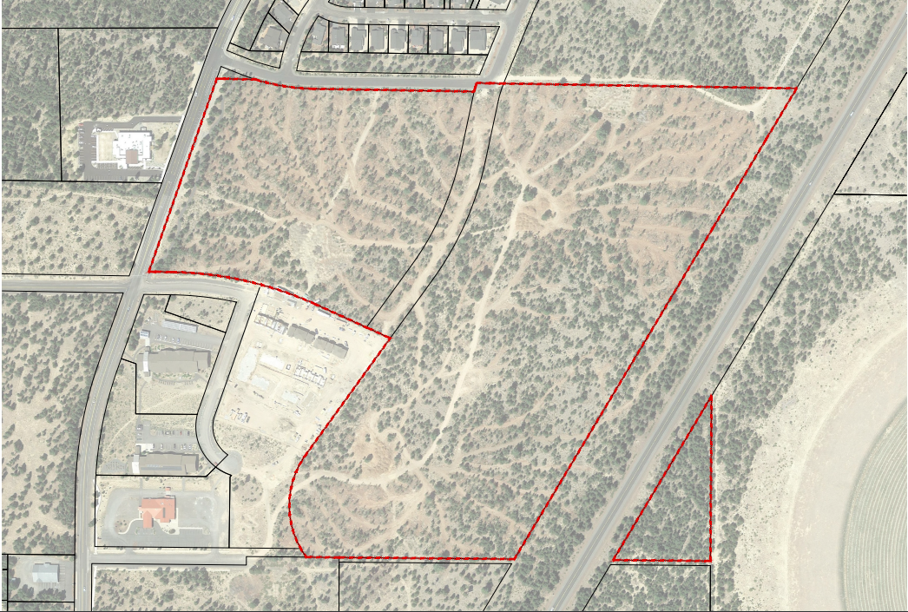
MIXED USE COMMERCIAL / RESIDENTIAL /
PARKS
CONCEPT
ONLY

Slide 3
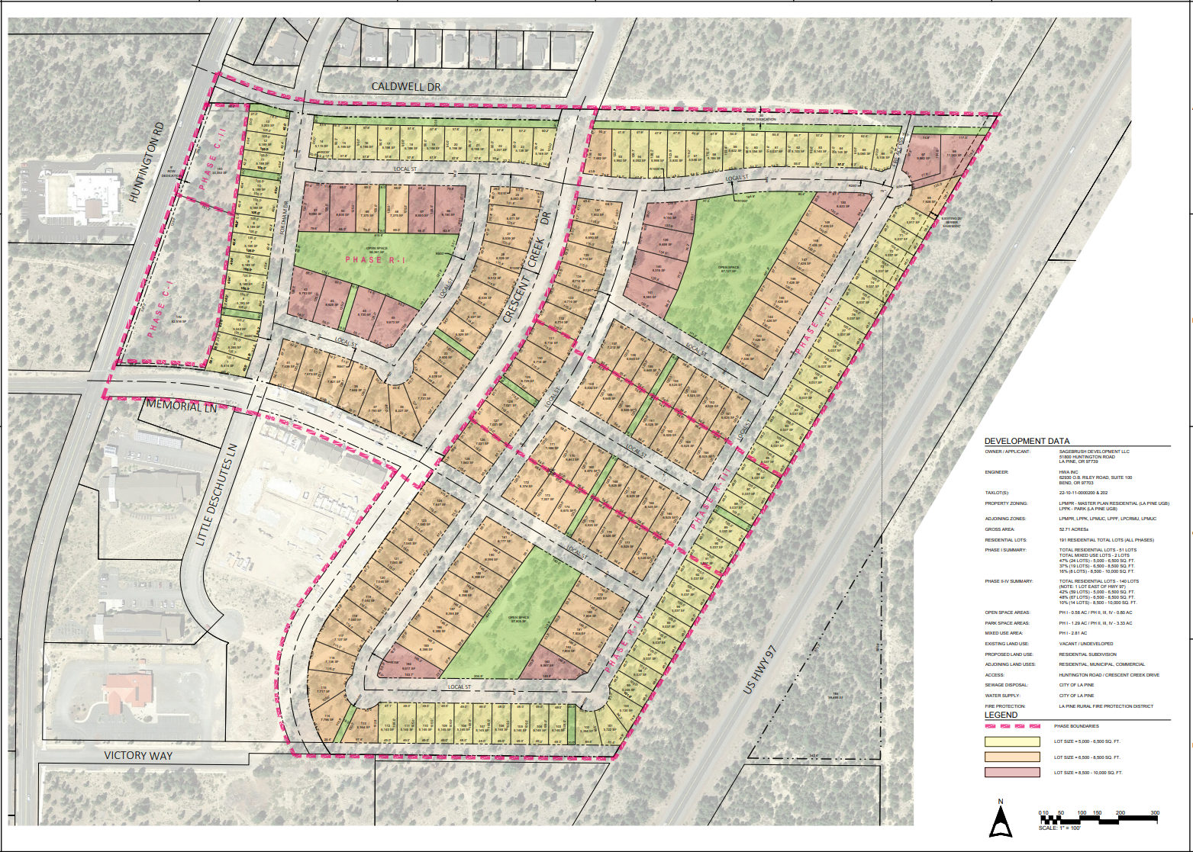
CONCEPT
ONLY

Slide 4
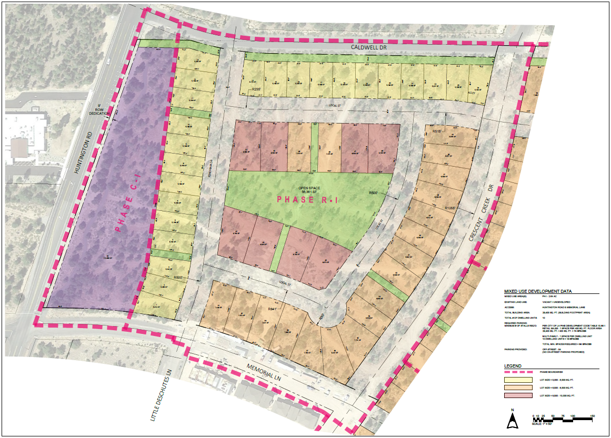
PHASE 1
CONCEPT
ONLY

Slide 5



Lot Sizes Ranging From 5,100 To 10,000 sq. ft.
The Reserve
In The Pines
Cascadia Style Homes
A Community To Call Home
CONCEPT
ONLY

Slide 6
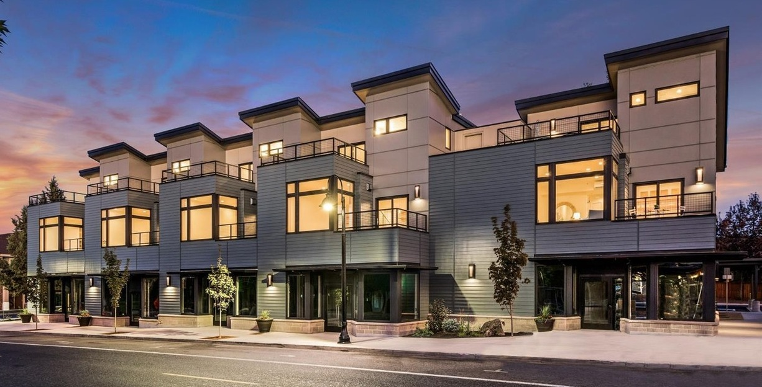


Coffeehouse
Bakery
Pub
Retail
Office Space
Medical
Dental
Non Amazon Businesses
CONCEPT
ONLY

Slide 7
CONCEPT
ONLY

Slide 8



Over 5+ Acres Dedicated To Park Space
The Reserve
In The Pines
Places To Gather
Crafted For All Ages & Lifestyles
CONCEPT
ONLY

Slide 9
THE RESERVE IN THE PINES
COMMUNITY
LIVABLE
SUSTAINABLE
AFFORDABLE
LA PINE
SMALL TOWN STRONG

